Slide 1
Commercial Open Source
Prof. Dr. Dirk Riehle
Friedrich-Alexander University Erlangen-Nürnberg
COSS C02
Licensed under CC BY 4.0 International
Notes:
It is Friedrich-Alexander University Erlangen-Nürnberg – FAU, in short.
Corporate identity wants us to say “Friedrich-Alexander University”.

Slide 2
Agenda
Definition (commercial open source)
Economic significance
The three core strategies
Single vendor open source firms
Open source distributor firms
Service and support firms
Benefits by business function

Slide 3
1. What is Commercial Open Source?

Slide 4
Definition of Commercial Open Source
Commercial open source software is open source software that
  Is being managed and developed by one or more software vendors
    For the purposes of generating revenues through derived products
A commercial open source software vendor is a software vendor that
  Manages and develops commercial open source software
The product itself, sold by a vendor, is never open source software

Slide 5












Examples of Commercial Open Source Firms

Slide 6
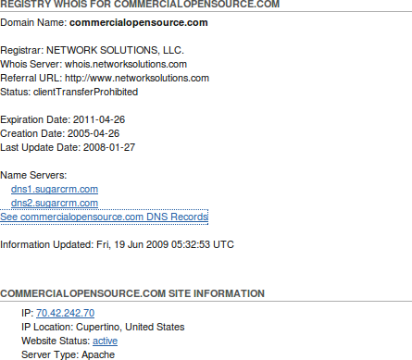
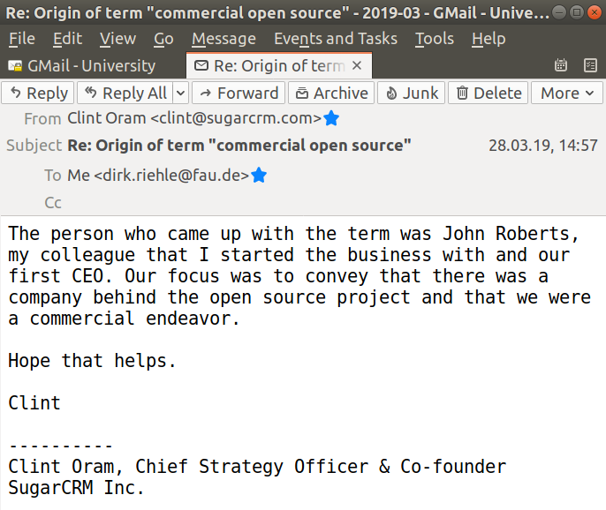
Origin of the Term Commercial Open Source

Slide 7
Software and the Commercial Product
}
Core product =
  Core software
  Additional functionality
  Complementary artifacts
  Self-help services
Basic product = core product +
  Fitness for use / certification
  Indemnification
  Support services
Whole product = basic product +
  Training
  Consulting
  Operations
Sometimes commercial
}
Always commercial

Slide 8
An Example Commercial Open Source Product [WR13]
Web Store
Direct Sales
DOC
Documentation
INC
Incident-based
support
Open
Source
Community
DOC
INC
UTIL
Utilities
UTIL
LIC
Commercial
license
Enterprise
Customers
LIC
UPD
UTIL
DOC
TRN
24x7
UPD
Update service
TRN
Training
ISV / OEM
LIC
UTIL
...
DOC
TRN
24x7
24x7 hotline
24x7

Slide 9
2. Economic Significance

Slide 10
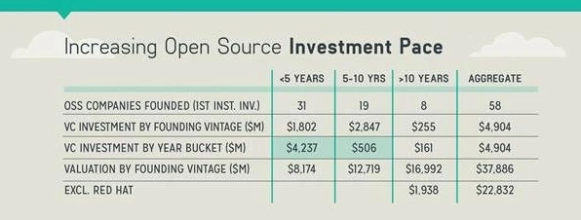
Open Source Investment Pace (2015)

Slide 11
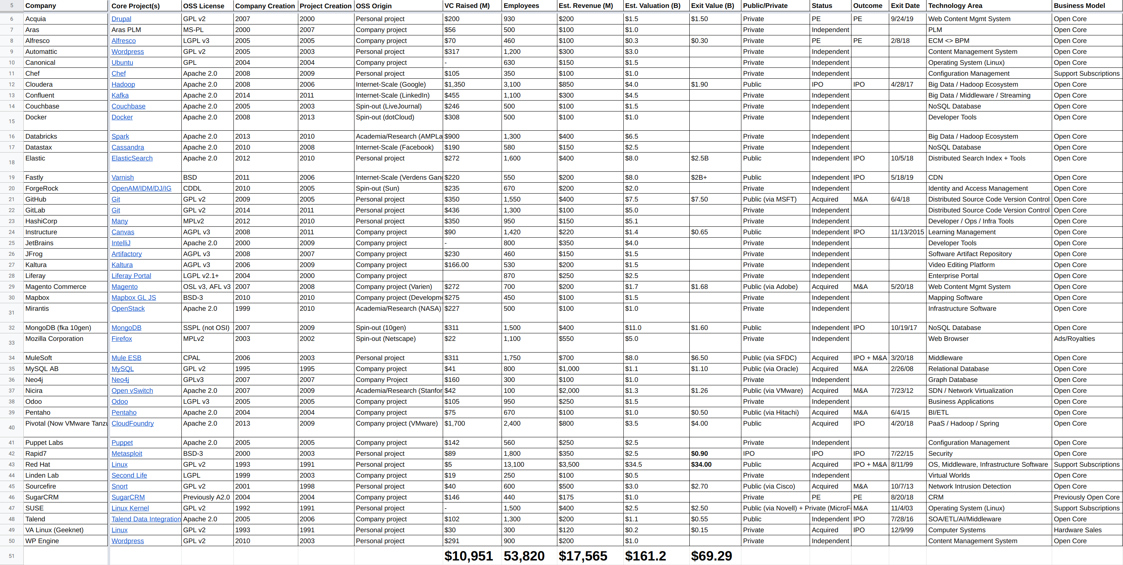
Wealth Creation Through Commercial Open Source [1]
[1] Retrieved from https://oss.cash on 2020-08-14

Slide 12
3. The Three Core Strategies

Slide 13
Sustainable Open Source (Recap)
Non-profit open source organizations
  Confederated community projects
  Open source vendor-led foundations
  Open source user-led foundations
For-profit open source firms
  Single-vendor open source firms
  Open source distributor firms
  Service and support firms
}
Commercial open source

Slide 14
Commercial Open Source by Intellectual Property
Single-vendor open source firms
  Provide a traditional software product to enterprises
  Exclusively own (key parts of) the software their business is based on
  Can attract venture capital; can have outsize returns
Open source distributor firms
  Provide a well working assembly of open source components
  Exclusively own non-core-software IP (configuration data, regression test suites, …)
  Can attract venture capital; can have outsize returns
Service and support firms
  Service existing community open source software
  Share in the IP, don’t dominate it
  Don’t attract venture capital

Slide 15
Open Source History (Recap)
User-led consortia (foundations)
2009
GenIVI Alliance
2005
Kuali Foundation
Single-vendor open source firms
1995
MySQL
2004
SugarCRM, Jaspersoft, Hyperic, ...
Developer-led foundations
(Natural persons and vendors)
2004 Eclipse Foundation
1999
Apache Software Foundation
2007
Linux Foundation
Open source distributor firms
1994
Red Hat
2004
Canonical
1992
Suse
2002
Univention
Service and support firms
2011
Hortonworks
1989
Cygnus Solutions
2005
Automattic
2009
MariaDB
Traditional community projects
1987
GCC
1993
Debian
1984
GNU Emacs
1991
Linux kernel
1996
PostgreSQL
2004
CentOS
year
Not a complete history: Events have been chosen for illustration purposes

Slide 16
4. Single-Vendor Open Source Firms

Slide 17
Definition of Single-Vendor Open Source
Single-vendor open source software is commercial open source software that
  Is being managed and developed by a single vendor
    For the purposes of generating revenues through derived products
A single-vendor open source software firm is a software vendor that
  Manages and develops single-vendor open source software
The product itself is never open source software

Slide 18
Characteristics of Single-Vendor Open Source
Single-vendor open source firms
  Control most or all of the key control mechanisms for open source
    In particular, they are (by definition) the sole copyright owner
  Can attract venture capital funding and can have outsize returns
Perhaps better be called neo-proprietary software vendors

Slide 19









Three Generations of Single-Vendor Open Source Firms
The pioneers (199x-2002)
The second wave (2002-2008)
The current breed (since 2008)
...
...
...

Slide 20












First and Second Generation Single-Vendor Open Source Firms

Slide 21















Third Generation Single-Vendor Open Source Firms [1]
[1] More at http://bit.ly/2NxhfIF; additions welcome

Slide 22
Community vs. Commercial Edition (Single-Vendor Firms)
Community edition
  Core product
    Core software
      Provided under an open source license
    Some complementary artifacts
    Self-help services
Commercial edition
  Core product
    Core software
      Provided under a commercial license
    Additional functionality
    Complementary artifacts
    Self-help services
  Basic product = core product +
    Fitness for use / certification
    Indemnification
    Support services
  Whole product = basic product +
    Training
    Consulting
    Operations

Slide 23
User to Customer Conversion
Community edition
  Home user
    Will never pay money
    But pays with time, feedback
  Line-of-business user
    Likes $0 line-items
    May be ignorant of risks
Commercial edition
  Enterprise customer
    Is willing to pay
    Requires enterprise features
  Internal IT department
    Has appropriate budget
    Wants professional support

Slide 24
The Commercial Open Source Challenge
Structure product and services so that you
  Maximize conversion to paying customer
  While benefiting from user community
  And keeping the competition at bay

Slide 25
Intellectual Property Management (Single-Vendor Firms)
Intellectual property rights imperative (of single-vendor open source)
  “Always act in such a way that you, and only you, possess the right to provide the open source project under a license of your choice.” [1]
Use contributor agreement to maintain ownership
  Almost all single-vendor open source firms require copyright transfer for any contributions to maintain full IP ownership [2]
[1] Riehle, D. (2009). The intellectual property rights imperative. Web-published.
[2] All you really need is a relicensing right though

Slide 26




Multi-Vendor Commercial Open Source Firms
Multi-vendor = no single dominant owner, rather shared control
  If so, best under a foundation to ensure reasonable governance
  Creates the problem of starving the project for new features
Apache Hadoop | Apache Kafka | Apache Lucene/Solr

Slide 27
5. Open Source Distributor Firms

Slide 28
Definition of Open Source Distribution
An open source distribution
  Is a well integrated collection of open source components and applications
An open source distributor firm
  Is firm that provides an open source distribution as a product or service

Slide 29
Characteristics of an Open Source Distribution
An open source distribution is a complex software where complexity stems from
  The number of components
  The individual complexity of a component
  Keeping the components working with each other
  Keeping the components up-to-date
A commercial open source distributor hides this complexity from the user (for pay)

Slide 30











Examples of Open Source Distributor Firms
Linux
OpenStack
Miscellaneous

Slide 31
Intellectual Property Management (Distributor Firms)
Distributor firms do not exclusively own the copyright to the code
Distributor firms can (and do) exclusively own
  Build processes for building the product from its components
  Compatibility matrices and configuration data
  Knowledge databases for support
  Tests and test suites
Distributors own “what’s in between” the open source code
  Sometimes manifests itself exclusively in people

Slide 32
Community vs. Commercial Edition (Distributor Firms)
Community edition
  Example Linux-based distributions
    Canonical
      Ubuntu
    Univention
      Univention Corporate Server
    Red Hat
      Fedora, CentOS
    Suse
      OpenSuse
  Product
    Core product
      Core software
        Provided under its open source license
      Complementary artifacts
      Self-help services
Commercial edition
  Example Linux-based distributions
    Canonical
      Ubuntu
    Univention
      Univention Corporate Server
    Red Hat
      Red Hat Enterprise Linux
    Suse
      Suse Linux Enterprise Server
  Product and services
    Core product
      Core software
        Provided under its open source license
      Additional functionality
        Provided under a commercial license
      Complementary artifacts
      Self-help services
    Basic product
    Whole product

Slide 33
6. Service and Support Firms

Slide 34
Definition of Service and Support Firm
An open source service and support firm is a consulting firm that
  Services and supports community open source software

Slide 35
Characteristics of Service and Support Firms
A service and support firm is a consulting firm
  Revenues mostly scale with labor
These firms contribute to the open source project they support
  Such positioning is important for marketing and sales

Slide 36
7. Benefits by Business Function

Slide 37
Why the Open Source Strategy?
To drive adoption (of product in market)
  To build a large (not necessarily paying) user base from which benefits accrue
What is not new
  Revenue sources
What is new
  Everything else (changes)

Slide 38
Benefits By Business Function
Marketing
  Generate leads more broadly, faster, cheaper
Sales
  Sell more effectively
Business development
  Identify partner opportunities better
Product management
  Identify market requirements faster better
Software development
  Build a superior product faster at lower cost
Product support
  Support better cheaper

Slide 39
Benefits to Marketing
Community word-of-mouth helps evangelize product
Community creates wider outreach than possible without
Frictionless distribution (no barriers) helps drive adoption
Download
Install
Use
Engage
Buy

Slide 40
Benefits to Sales
Market product
Engage in
comp. sales
Win contract!
Provide open source
Track users
Generate leads
from behavior
Connect users
of organization
Identify champion
Make sales call

Slide 41
Benefits to Business Development
User innovation helps identify strategic partners

Slide 42
Benefits to Product Management
Identify customer requirements more readily
Explore new market segments more cheaply
Let users explore feature space for you
Let users explore alternatives at no costs

Slide 43
Benefits to Software Development
Find bugs fast
Get bug reports for free
Get code contributions for free
Explore design and implementation
Recruit and hire more effectively
“Source code [is just] 10% of the effort.” [L07]

Slide 44
Benefits to Support
Get help with self-help services
Reduce overall support load through self-help
Feed self-help services into commercial documentation

Slide 45
But at What Costs?
Some retraining of traditional business functions
Establishment of new community management function

Slide 46
Summary
Definition (commercial open source)
Economic significance
The three core strategies
Single vendor open source firms
Open source distributor firms
Service and support firms
Benefits by business function

Slide 47
Thank you! Questions?
dirk.riehle@fau.de – http://osr.cs.fau.de
dirk@riehle.org – http://dirkriehle.com – @dirkriehle
DR

Slide 48
Credits and License
Original version
  © 2020 Dirk Riehle, some rights reserved
  Licensed under Creative Commons Attribution 4.0 International License
Contributions
  None yet

